Slide 1
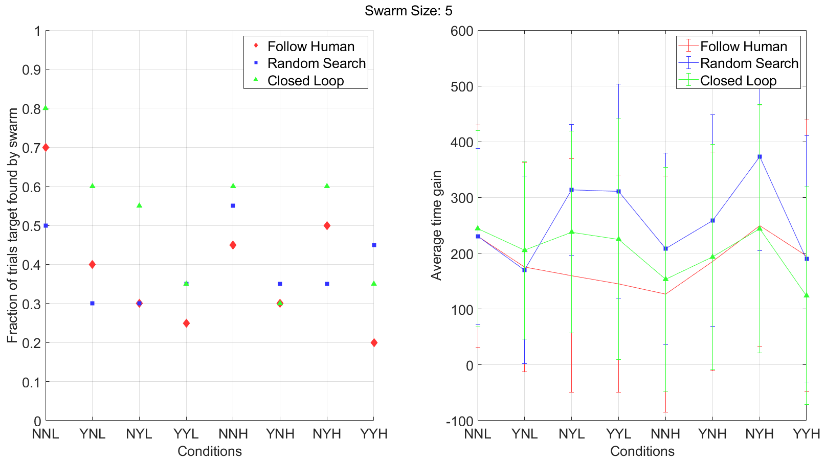
a)
b)

Slide 2
LSTM + Dropout layer
Concat
Sigmoid (Probability)
Input Data (Speed and Turn rate)
1D Convolution + Batch normalization
1D Convolution + Batch normalization
1D Convolution + Batch normalization

Slide 3
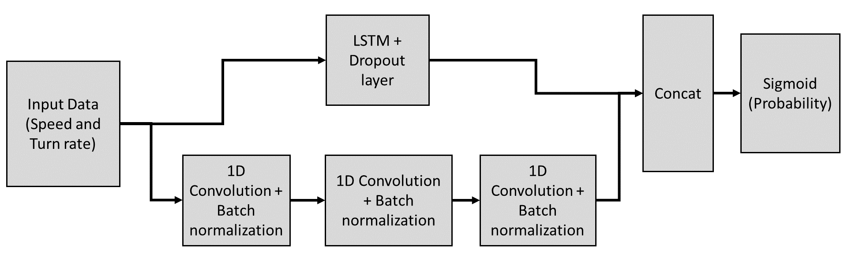

Slide 4
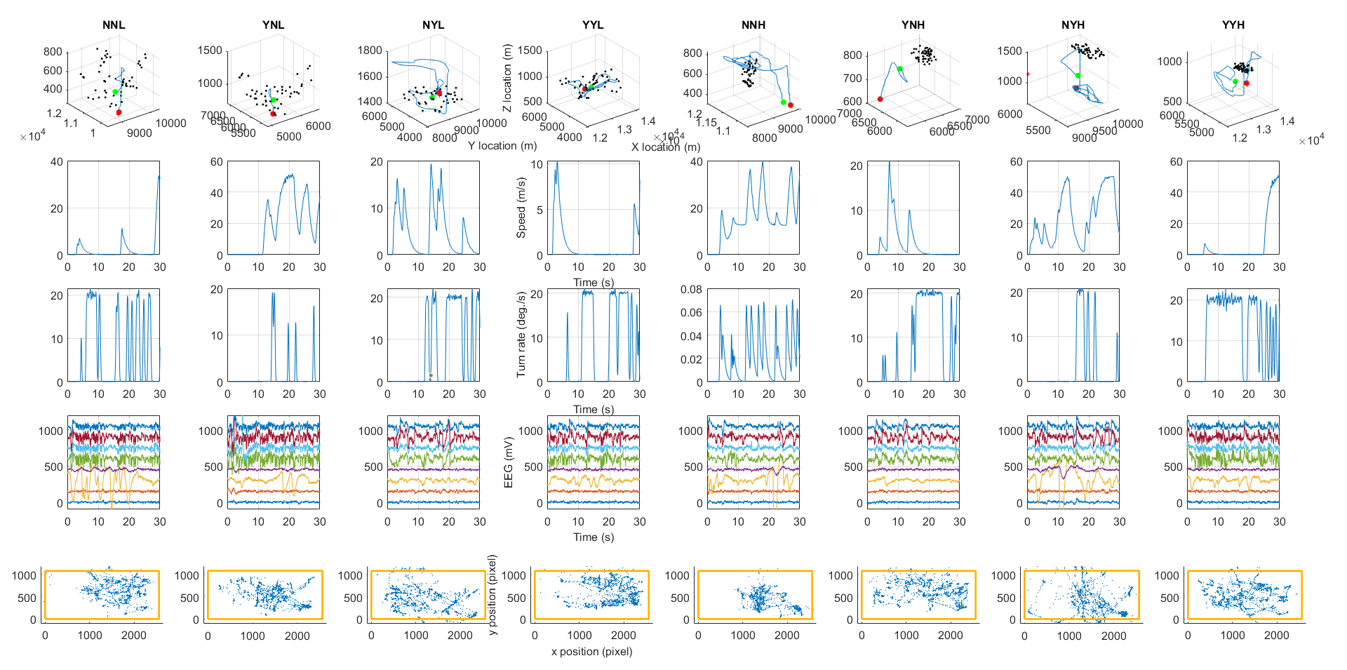
a)
b)
c)
d)
e)

Slide 5
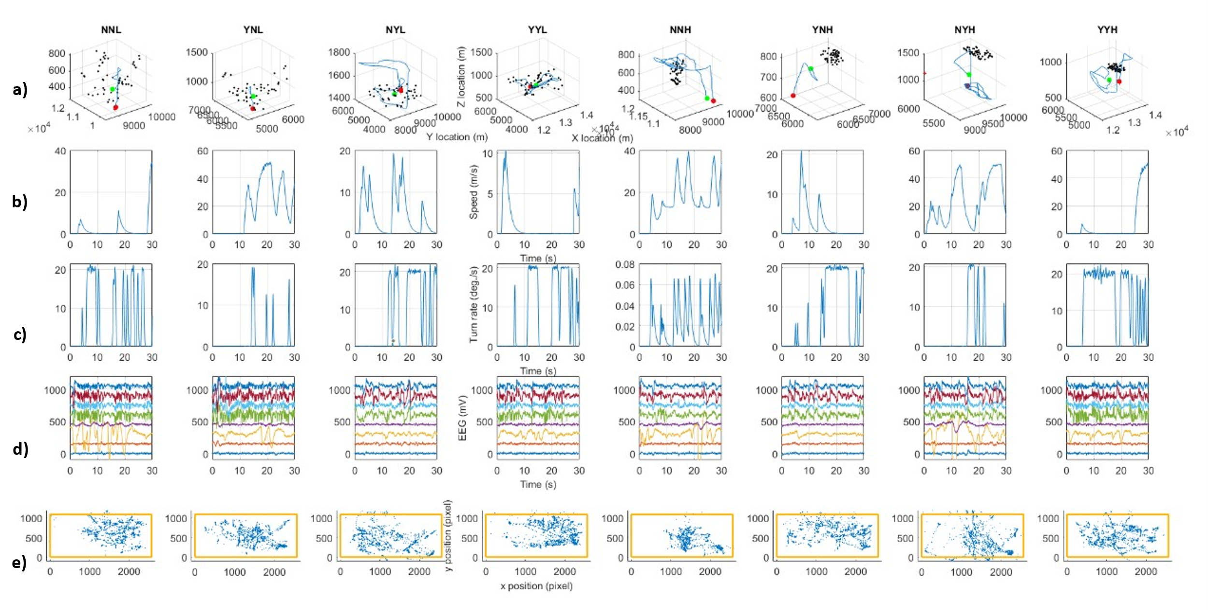

Slide 7
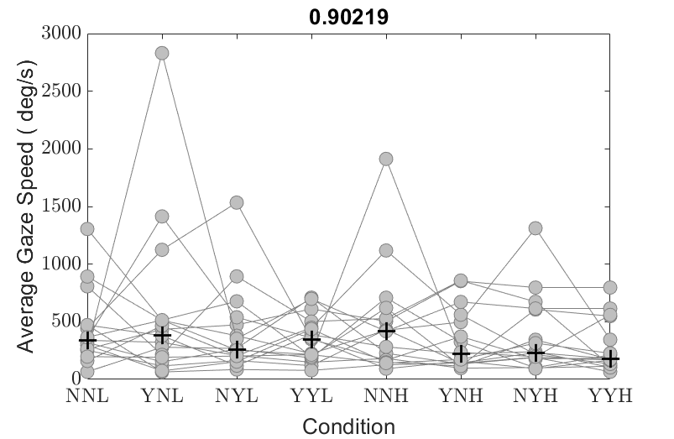
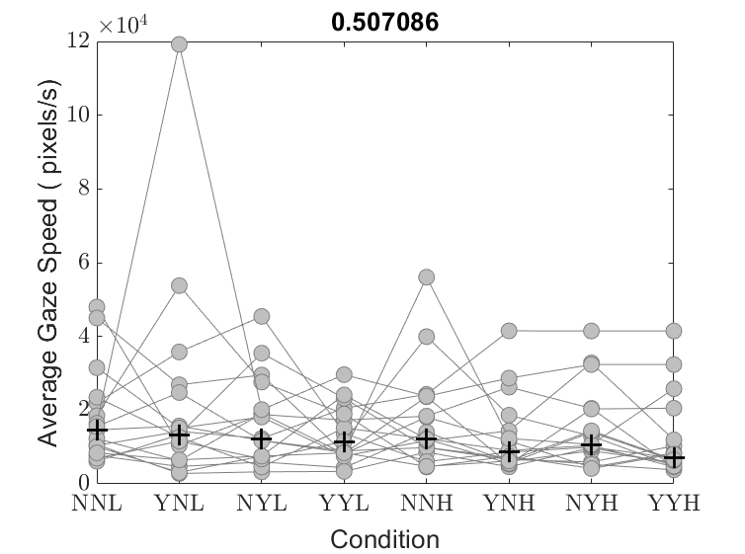
a)
b)

Slide 8
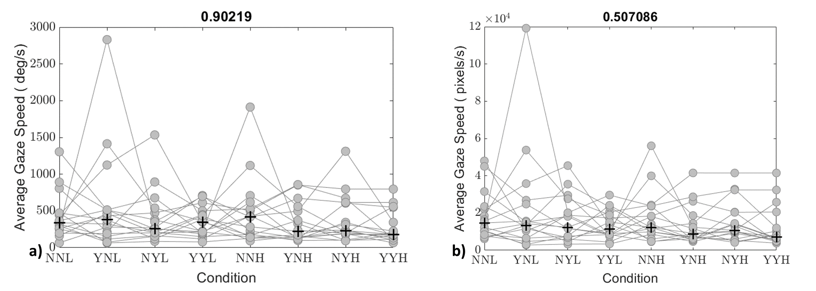

Slide 9
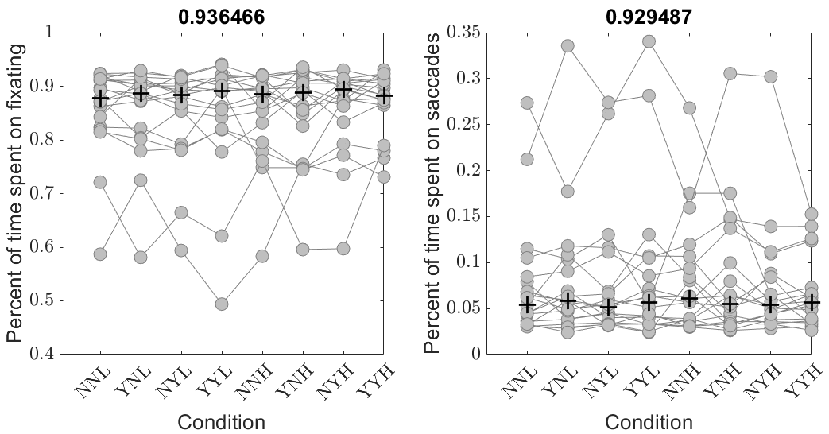
a)
b)

Slide 10
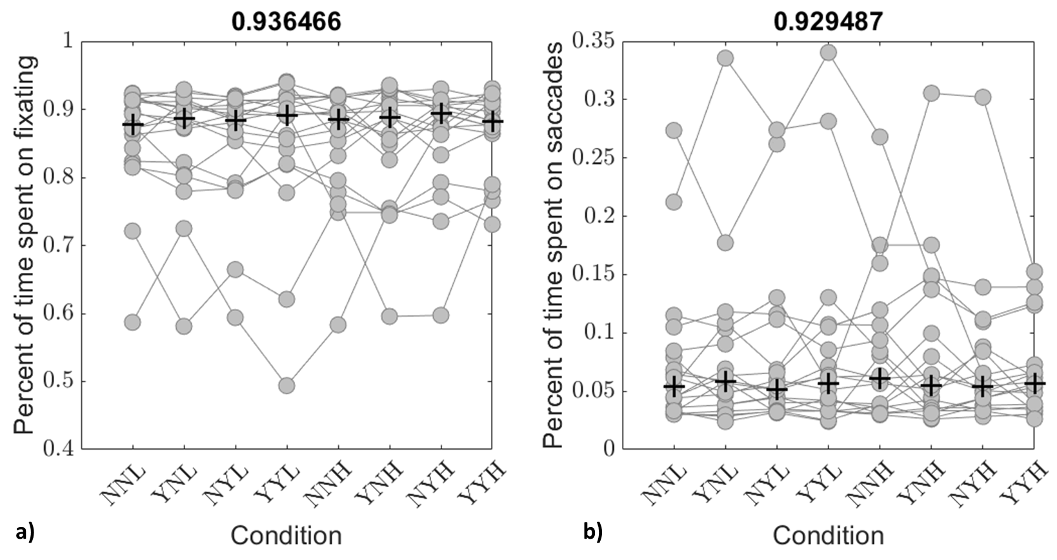

Slide 11
